Slide 1


Edu

Slide 2
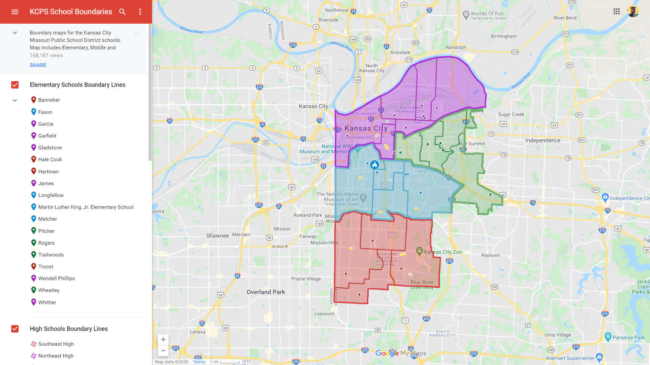

Slide 3
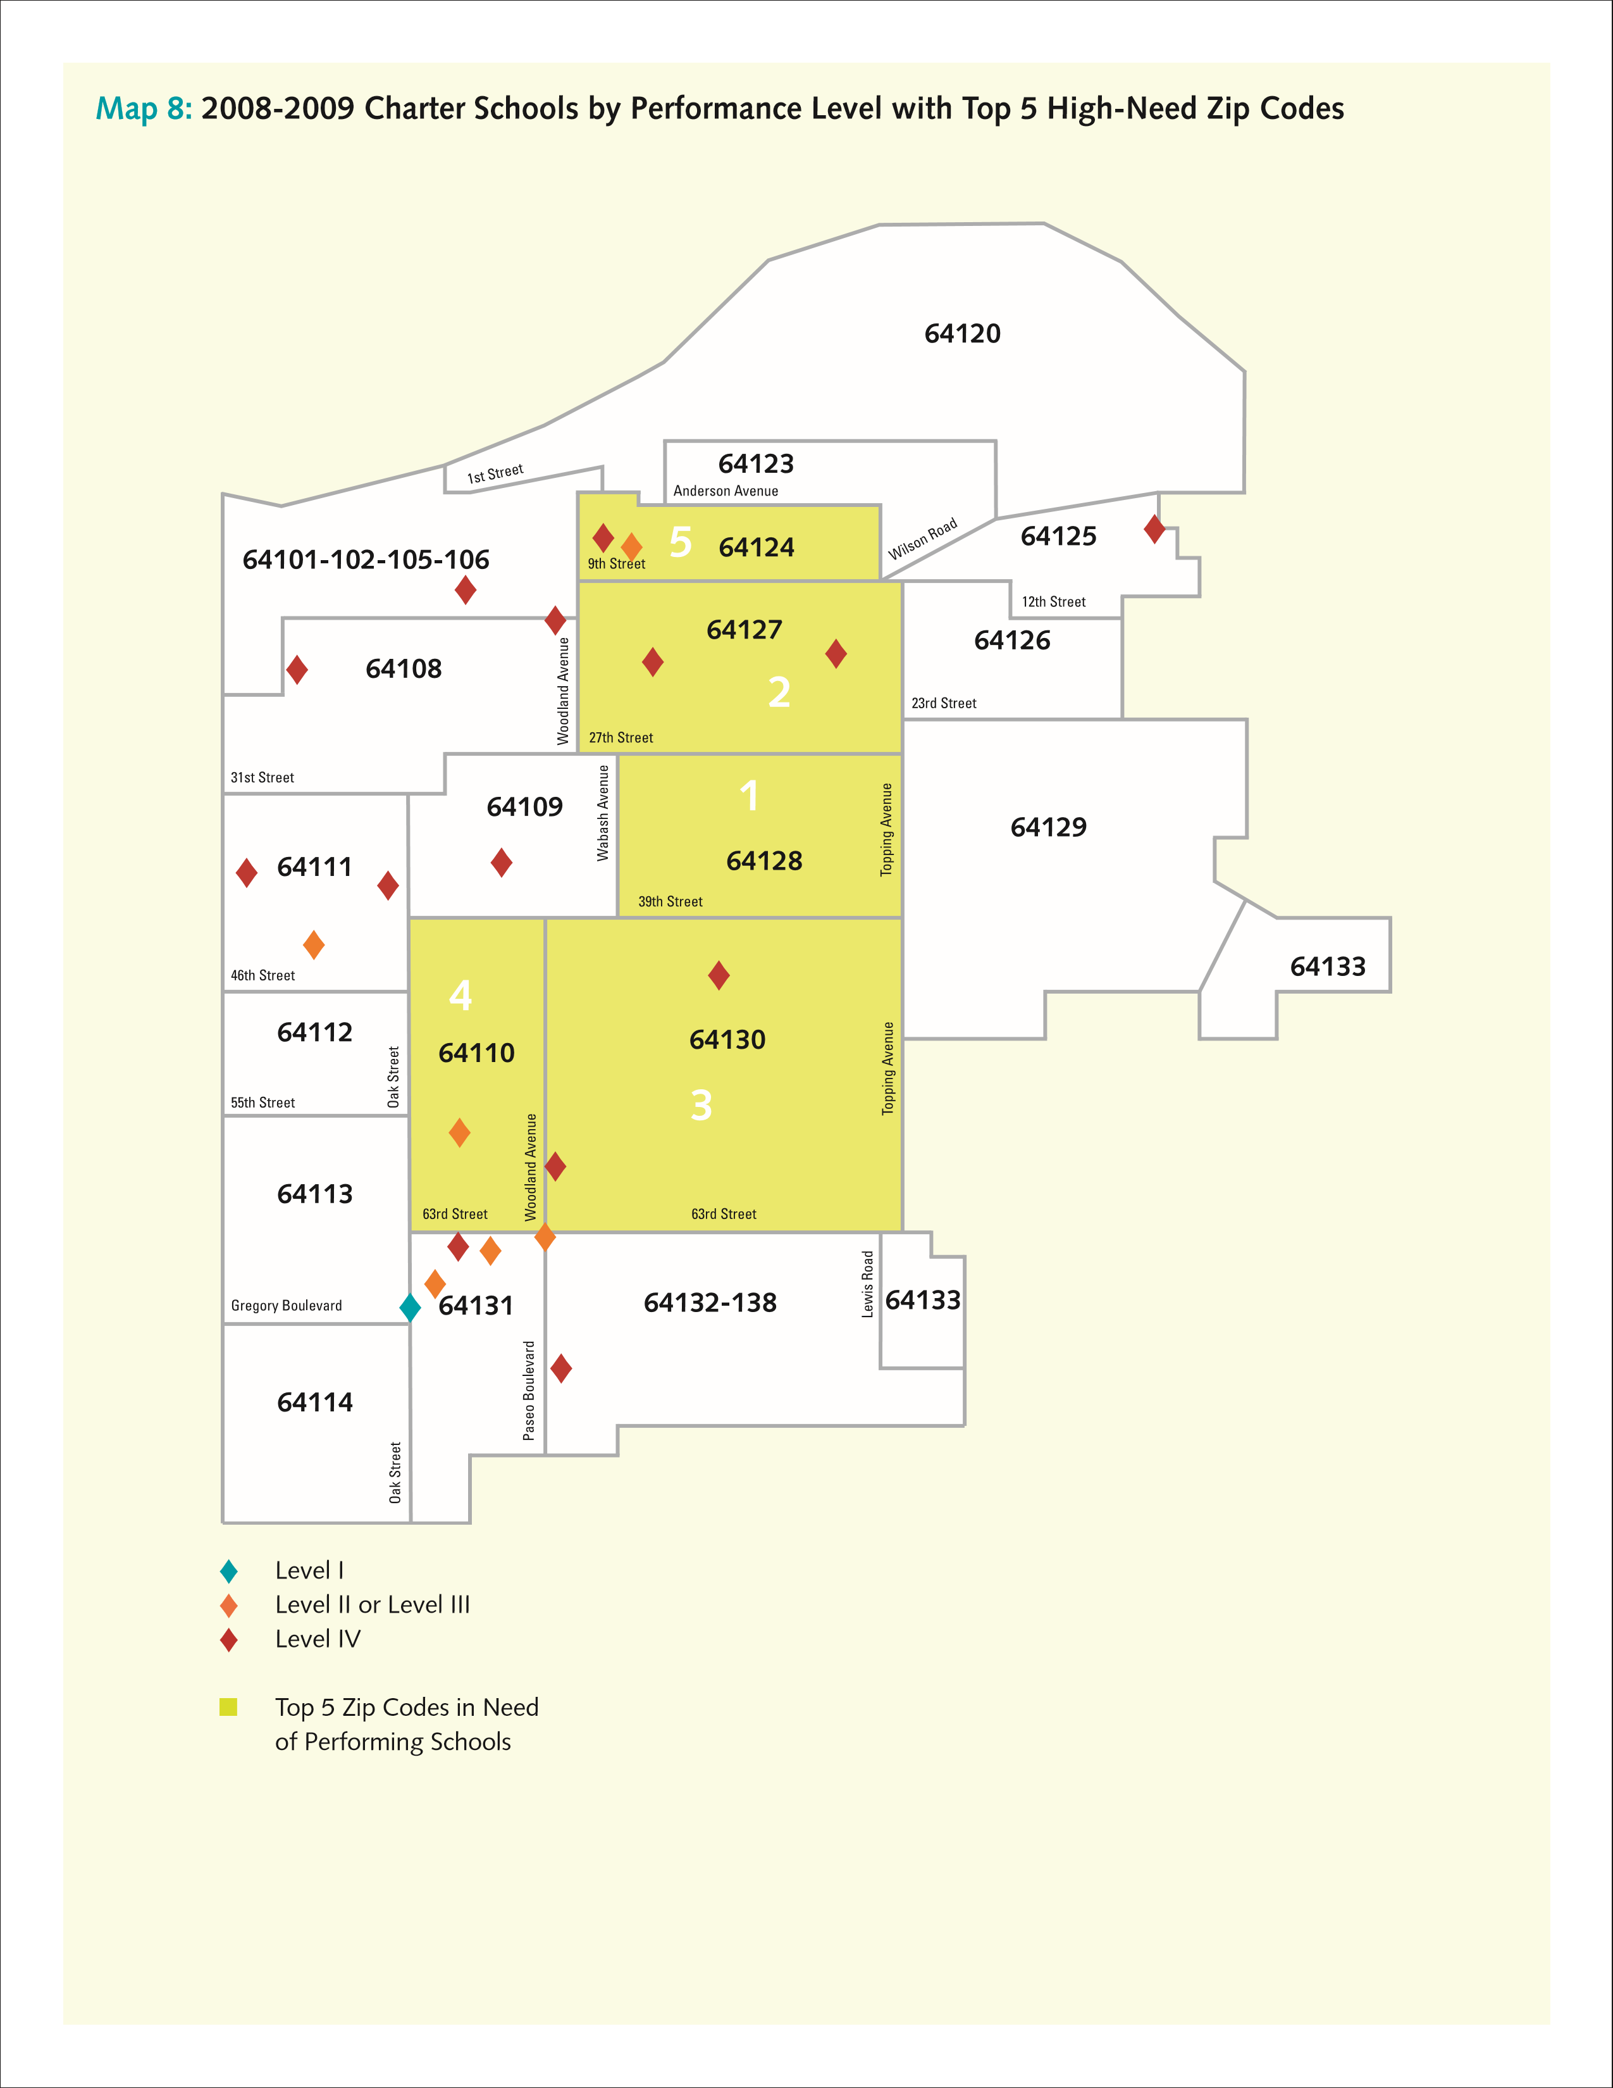

Slide 4
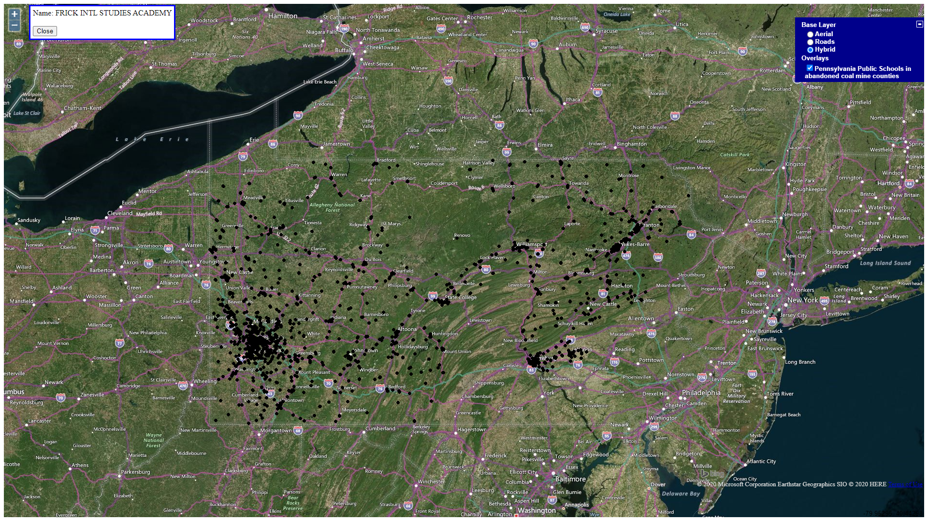
Ref: https://catalog.data.gov/dataset/public-schools-polygon

Slide 5





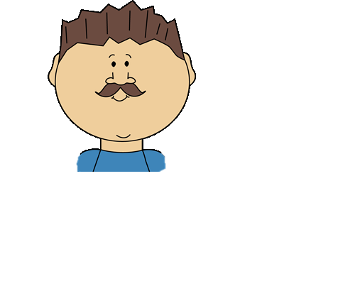
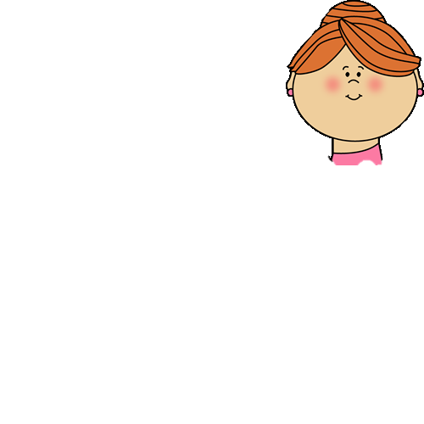


Student
Search
Enroll
Give
Feedback
Edu KC
Parent
Child
Profile
Search
Enroll
Give
Feedback
LESSON v1
LESSON v2
Community
Member
Add
Program
Get
Matches
Enroll
Get
Feedback
Update
Program

Slide 6



Prepare
the environment
Deploy
The model into app
Experiment
with the model & data

Slide 7
Data

Slide 8









National Center for Education Statistics
ArcGIS Hub
Data
Sources

Slide 9
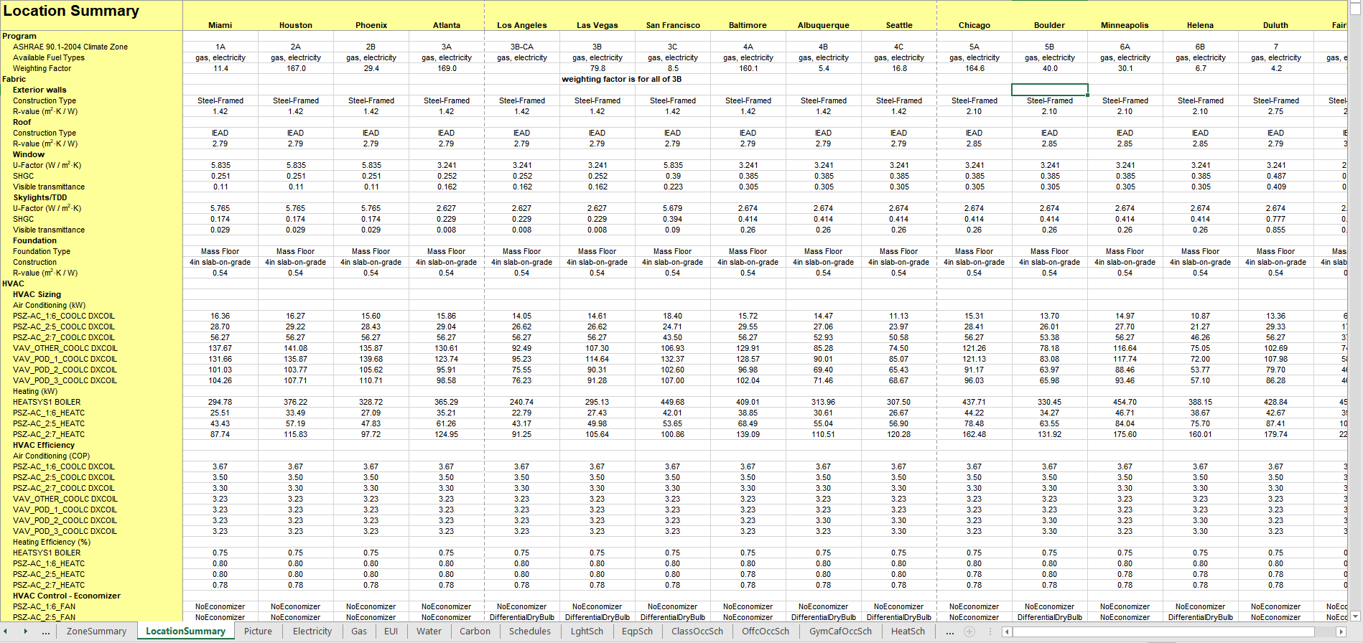

Slide 10
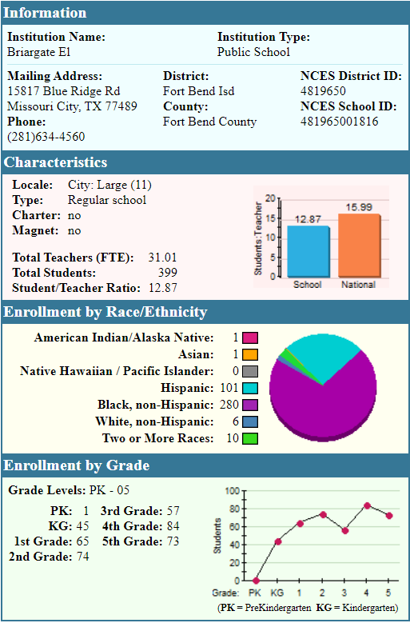
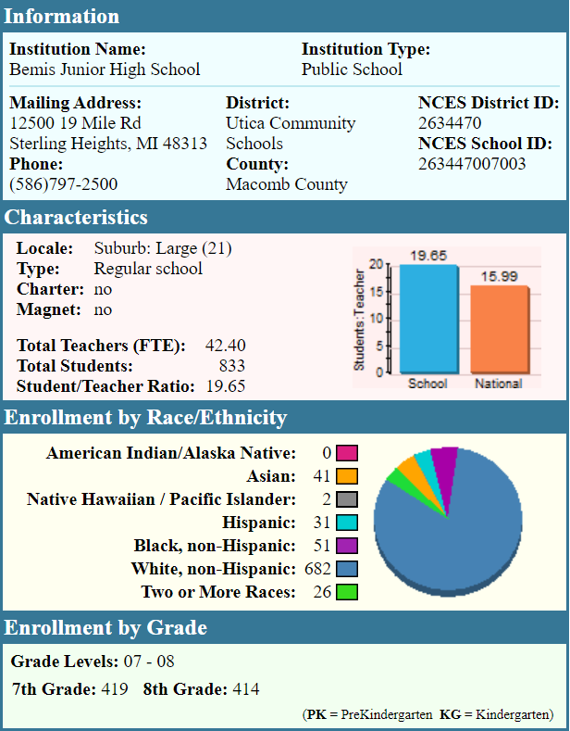
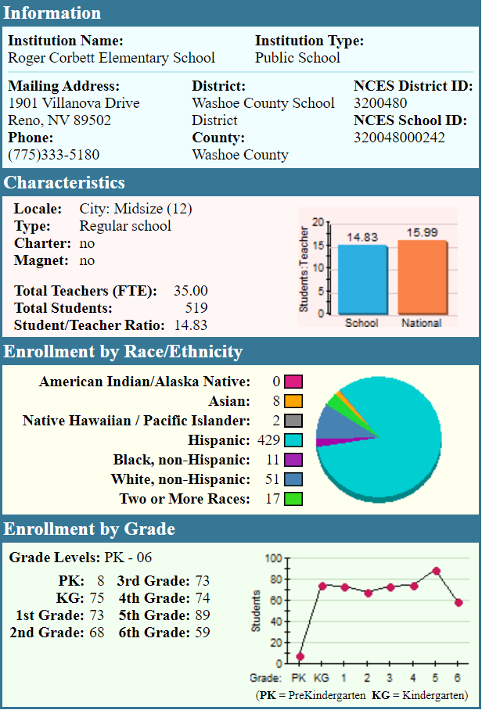
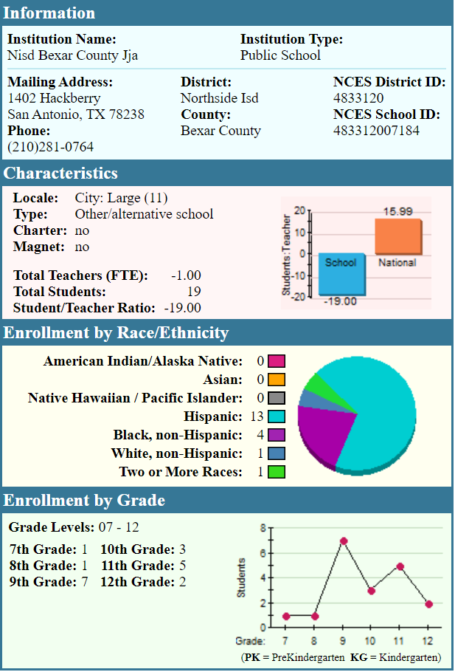

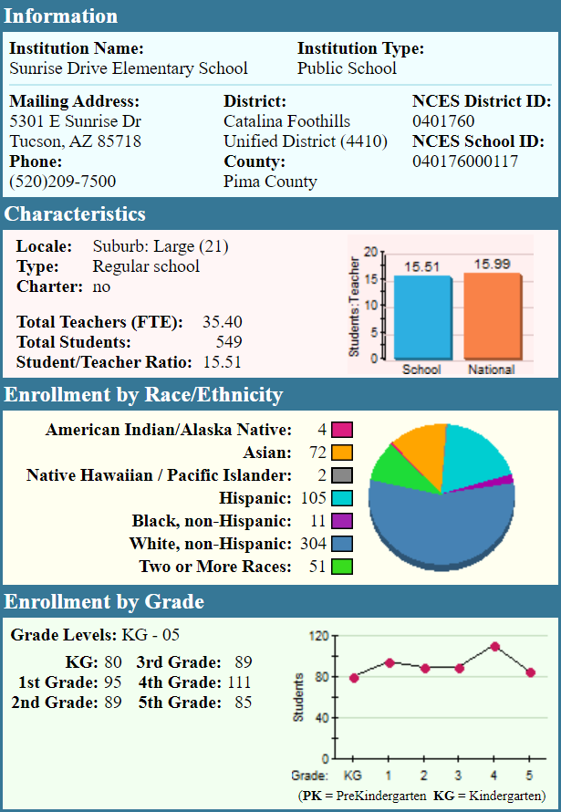
Ref: NCES

Slide 11
Models

Slide 12
Category

Slide 13
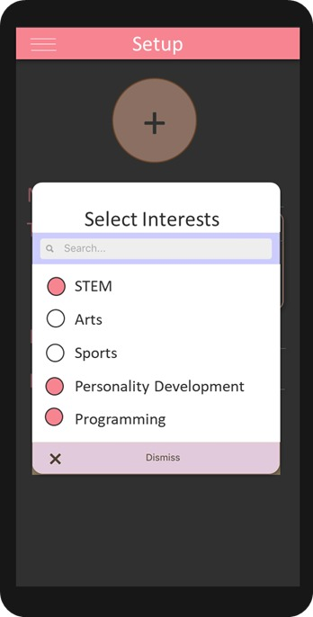



Features
title
location
category
image
description
save
retrieve
retrieve
details
Classification
Model
Database
Server
provider
distance
ages
price
campus

Slide 14
Affordability

Slide 15
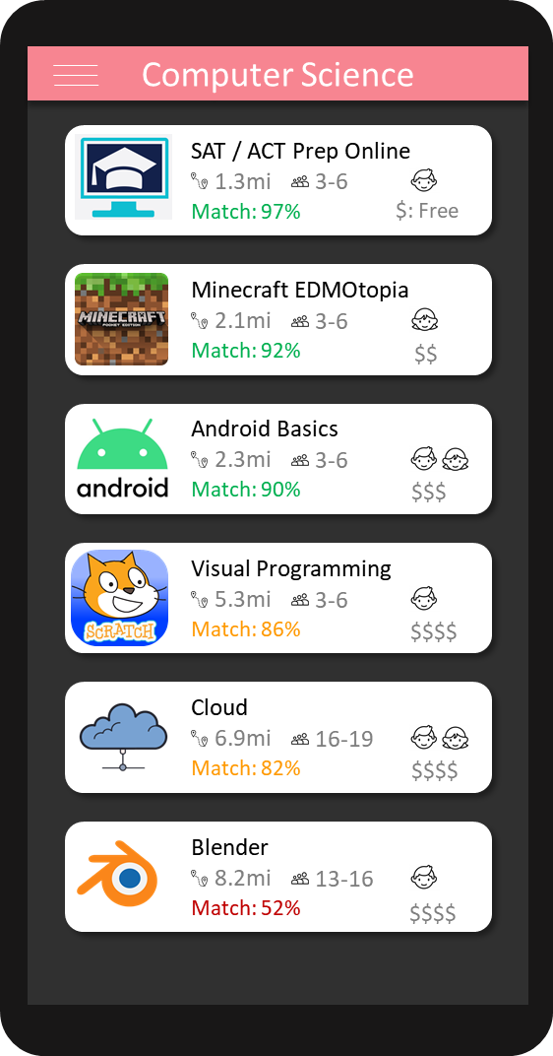
category
details
save
retrieve
retrieve
price
NLP
Model
Database
Server
reviews
Features

Slide 16
Reputation

Slide 17
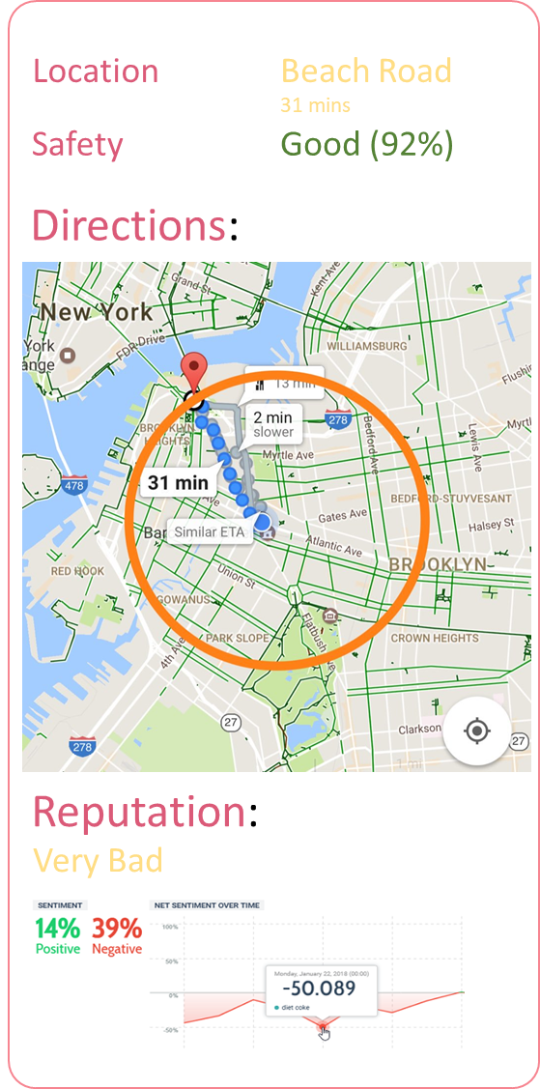
Edu KC
reviews
ratings
save
retrieve
retrieve
votes
NLP
Model
Database
Server
discussions
Features

Slide 18
Health & Safety

Slide 19
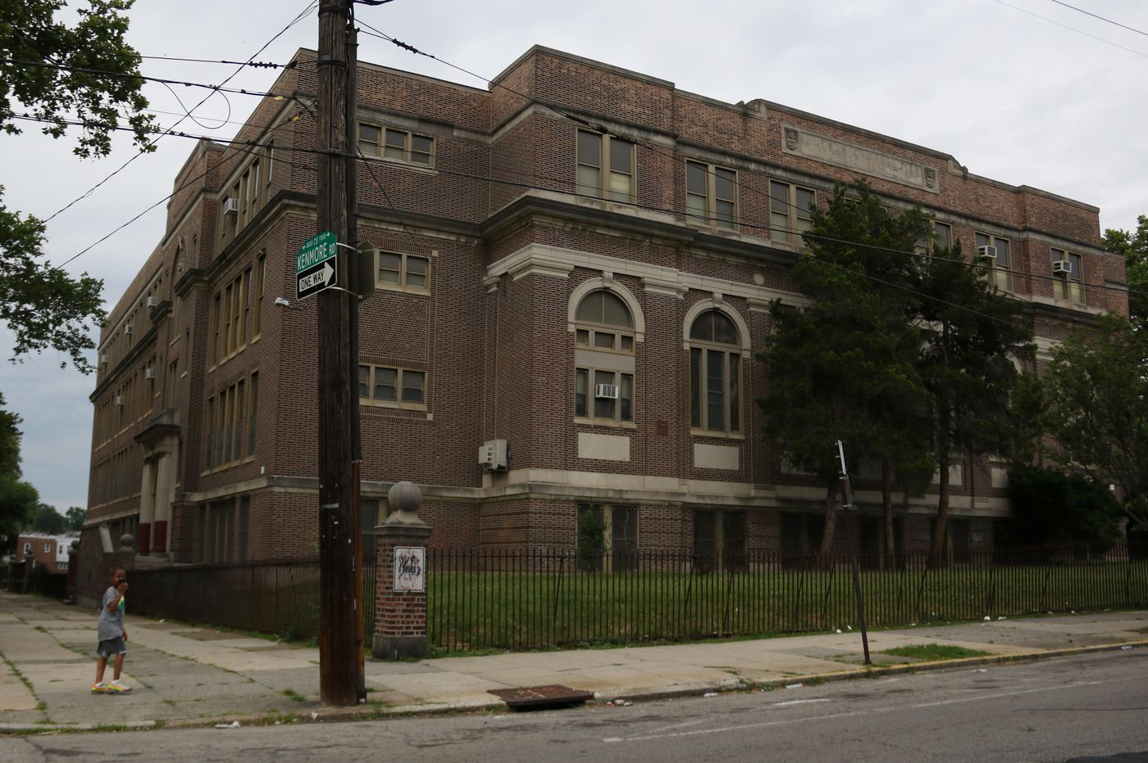
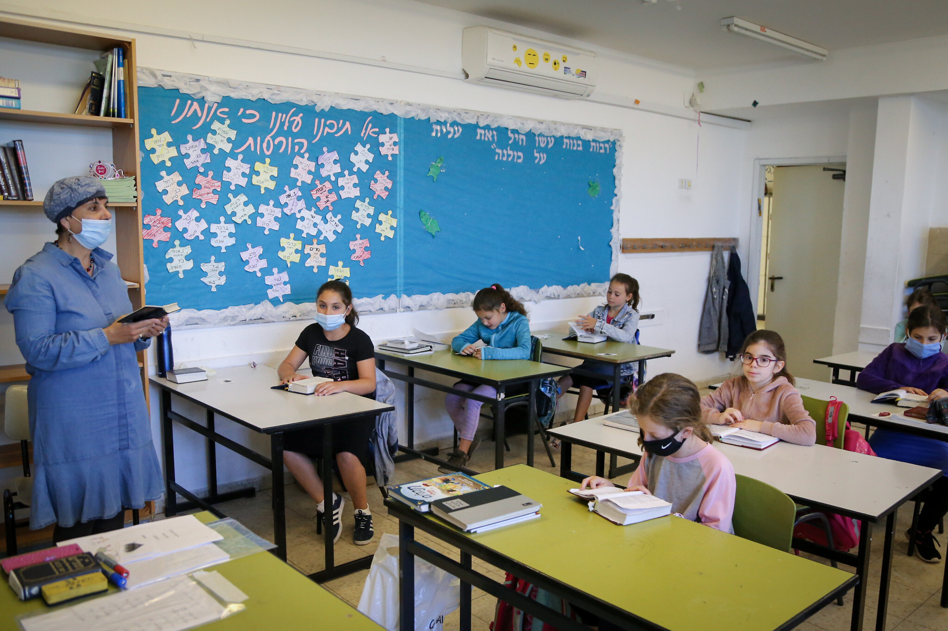
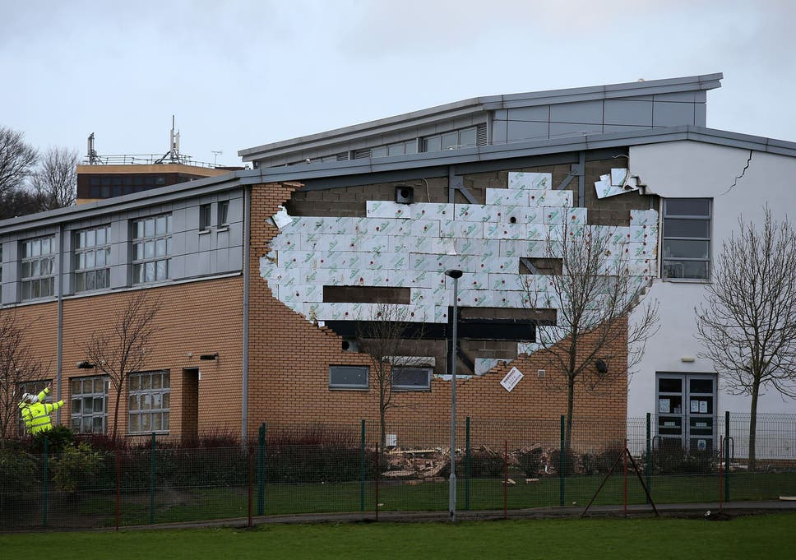
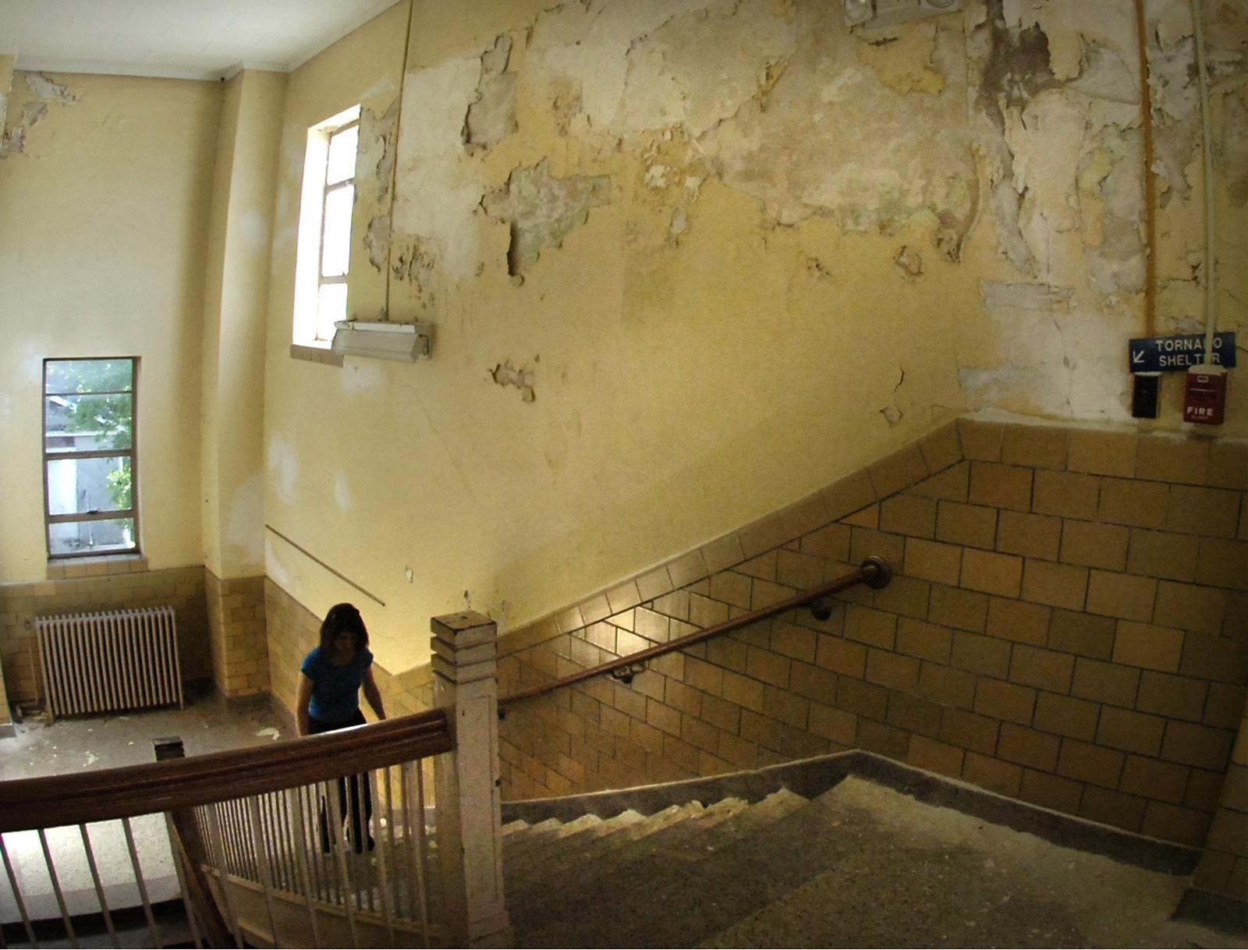
External
Internal
Safe
Not
Safe

Slide 20
Edu KC
Good external
Good internal
save
retrieve
retrieve
Bad external
Resnet
Model
Database
Server
Bad internal
Features

Slide 21
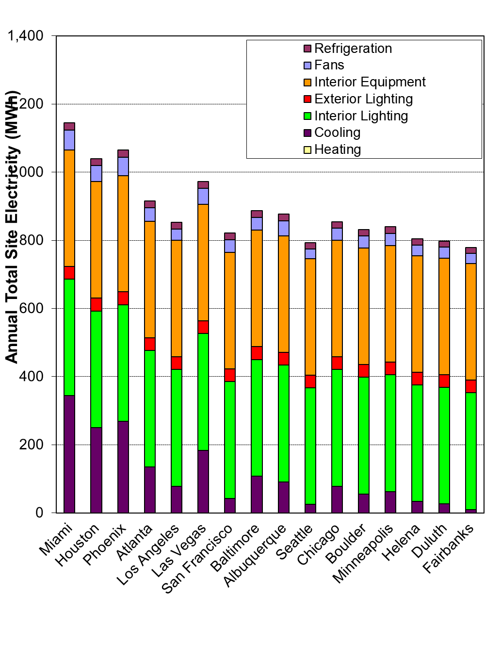
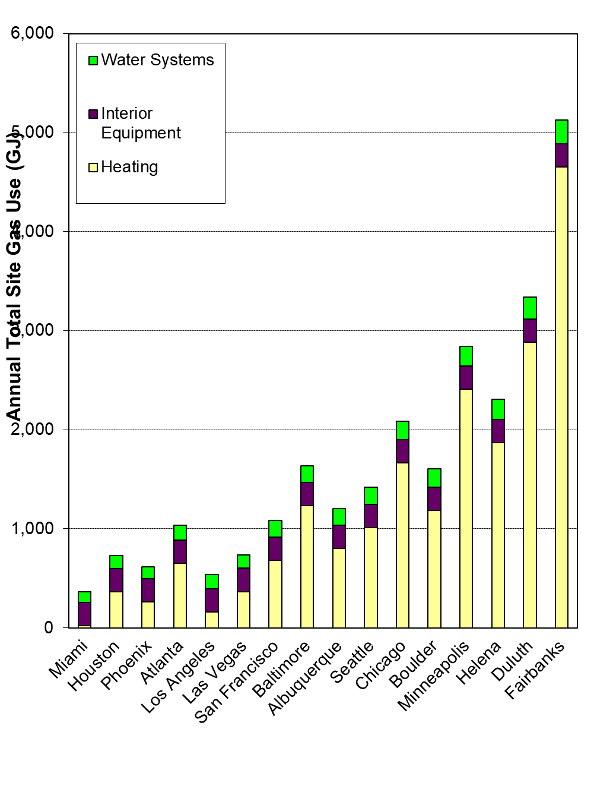
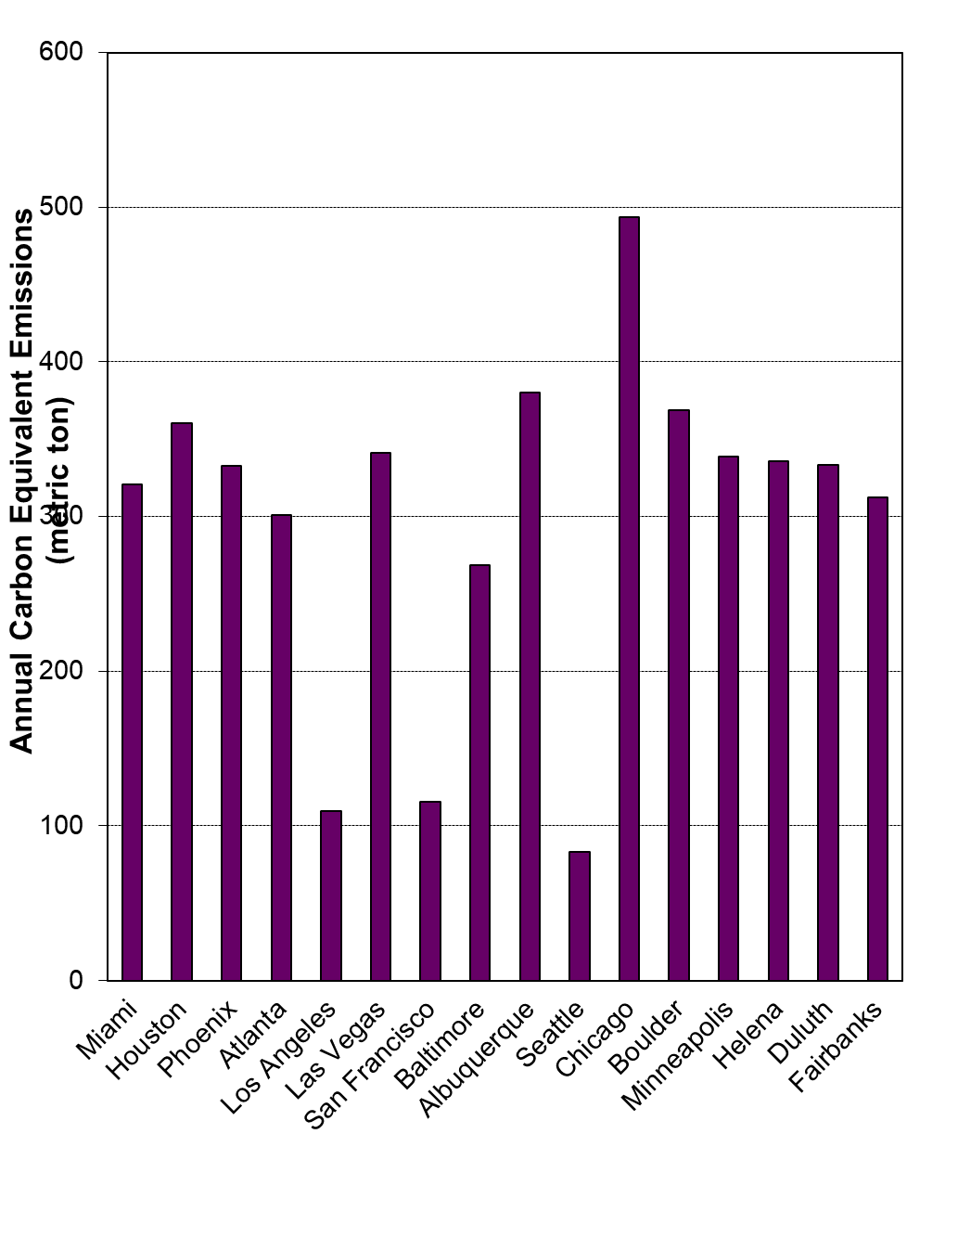
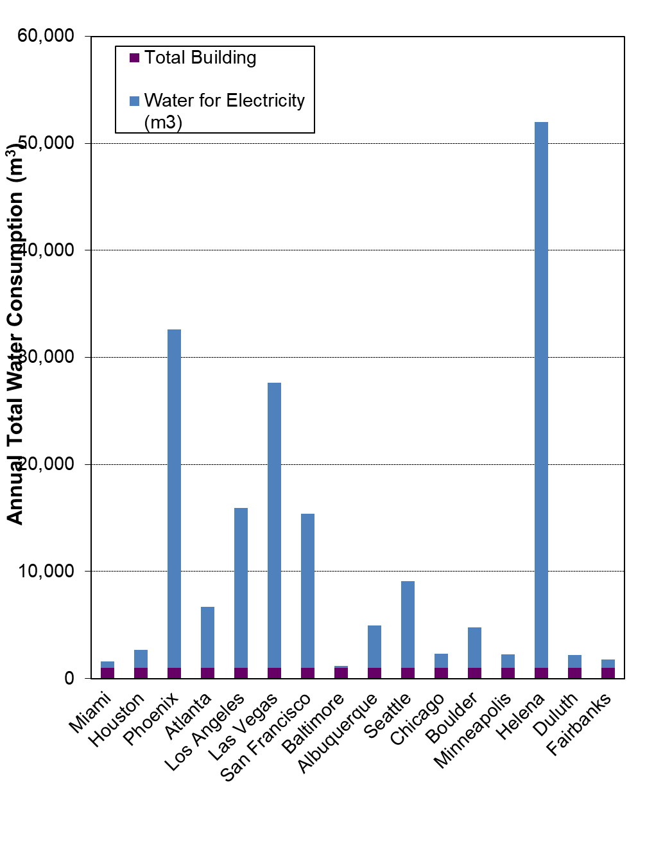
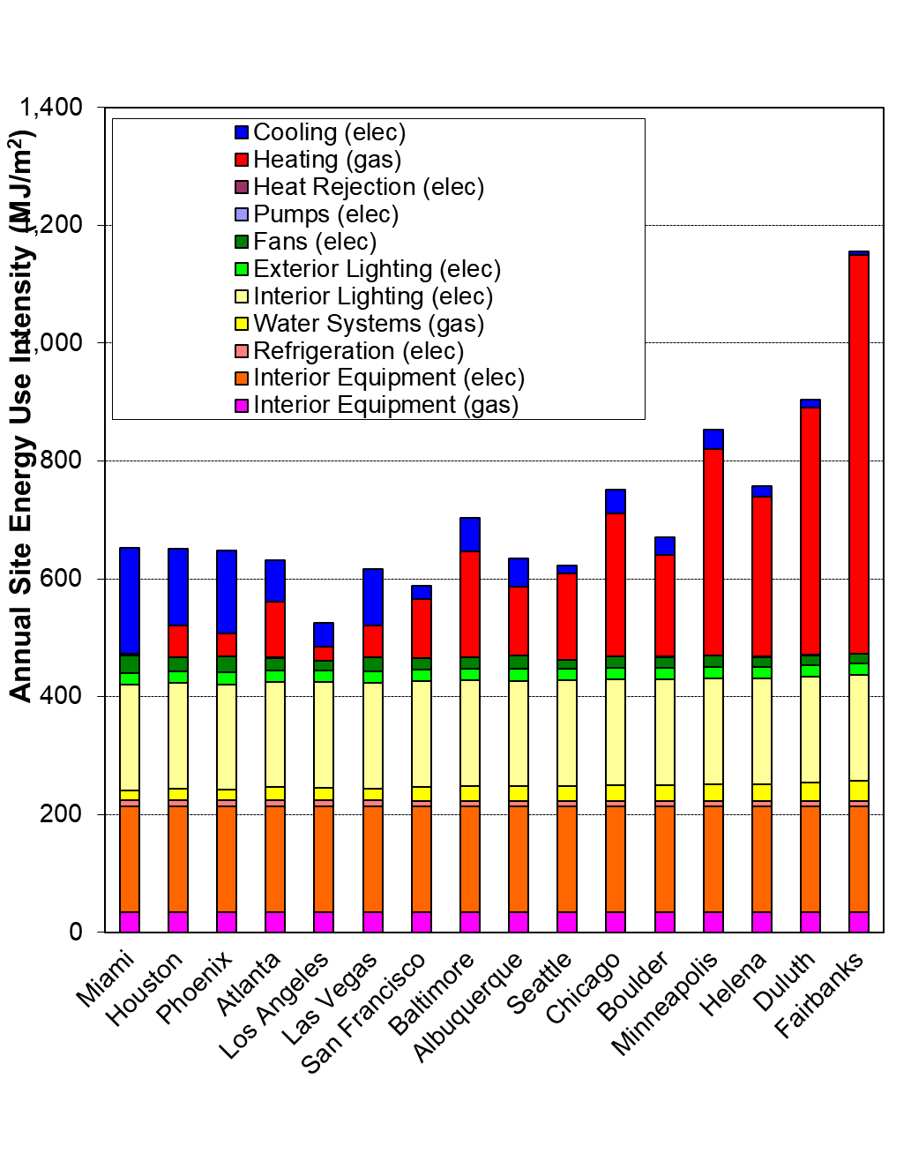
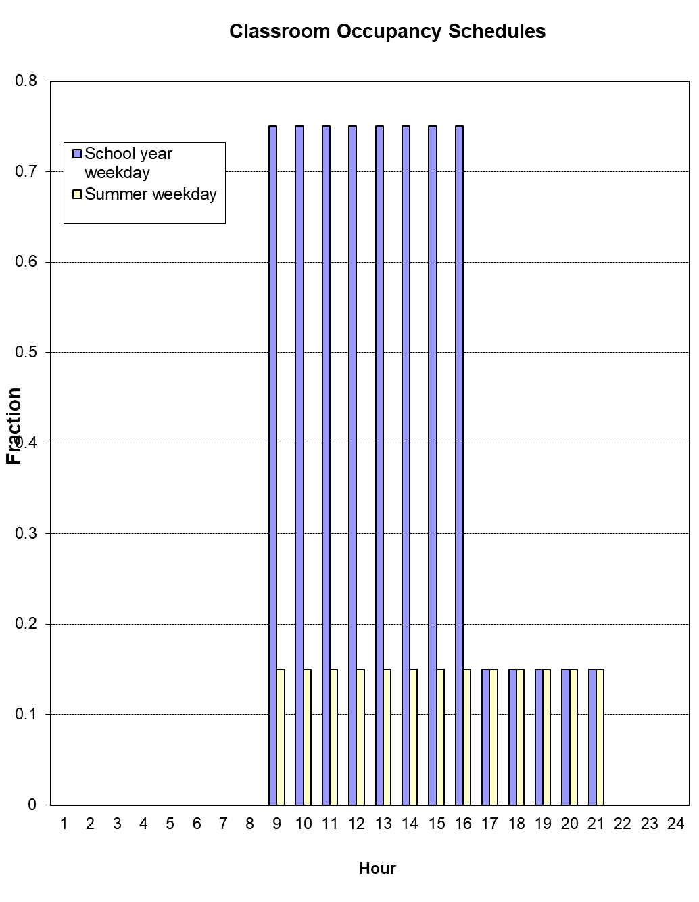

Slide 22
Feedback

Slide 23
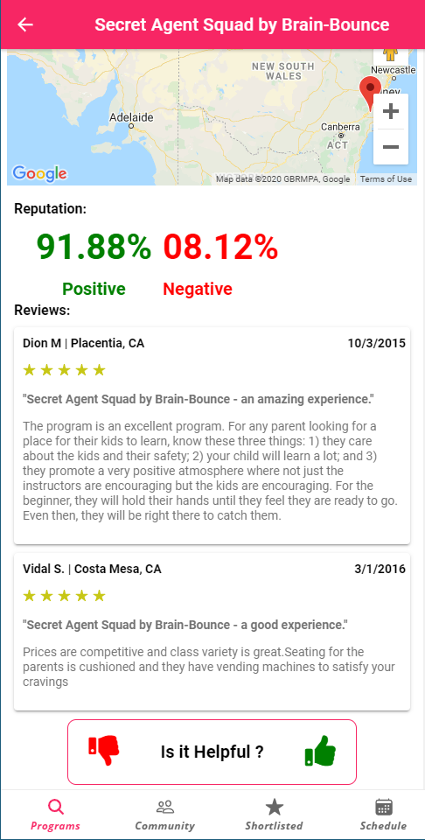
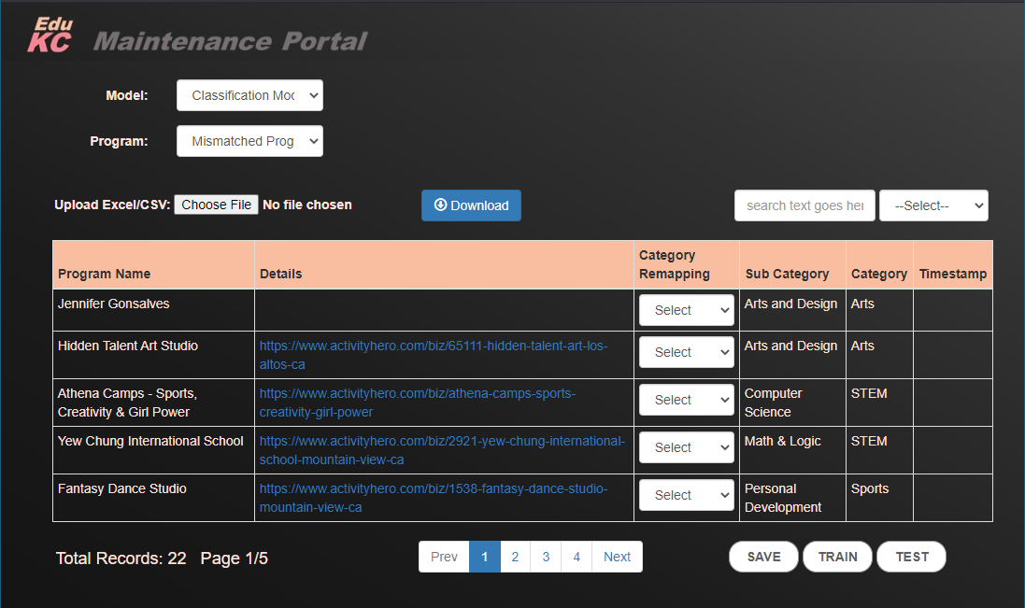
save
train
Database
Re-train
Model
User

Slide 24
Putting it together

Slide 25
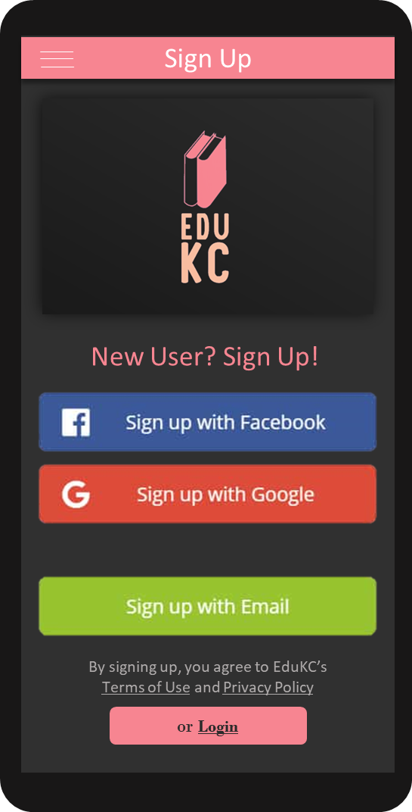

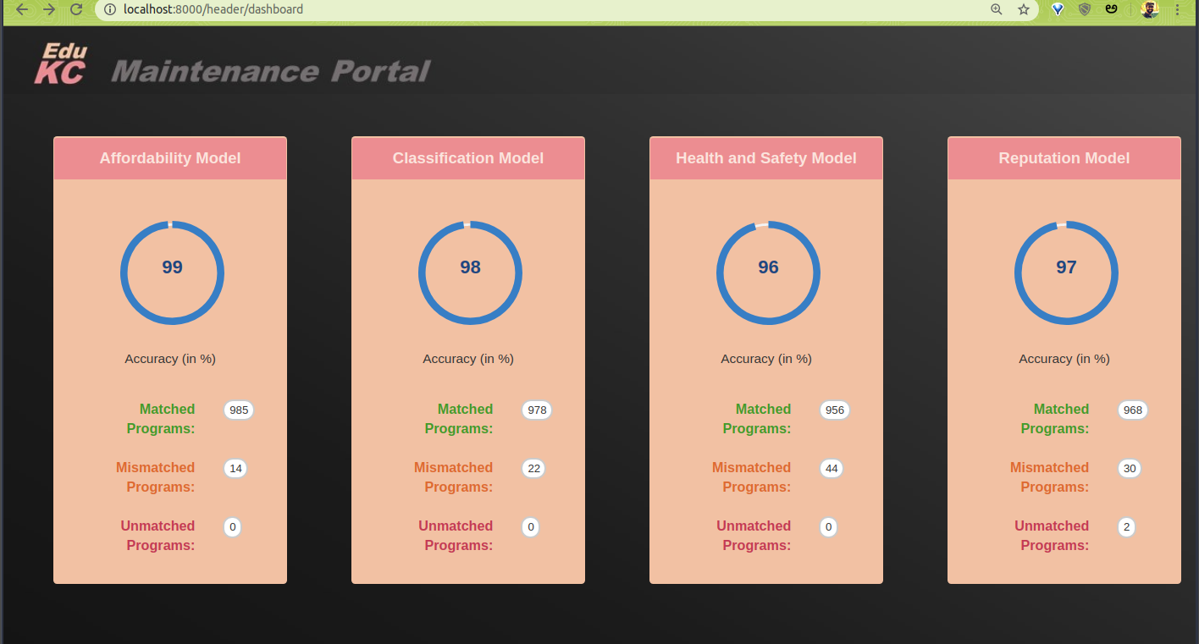





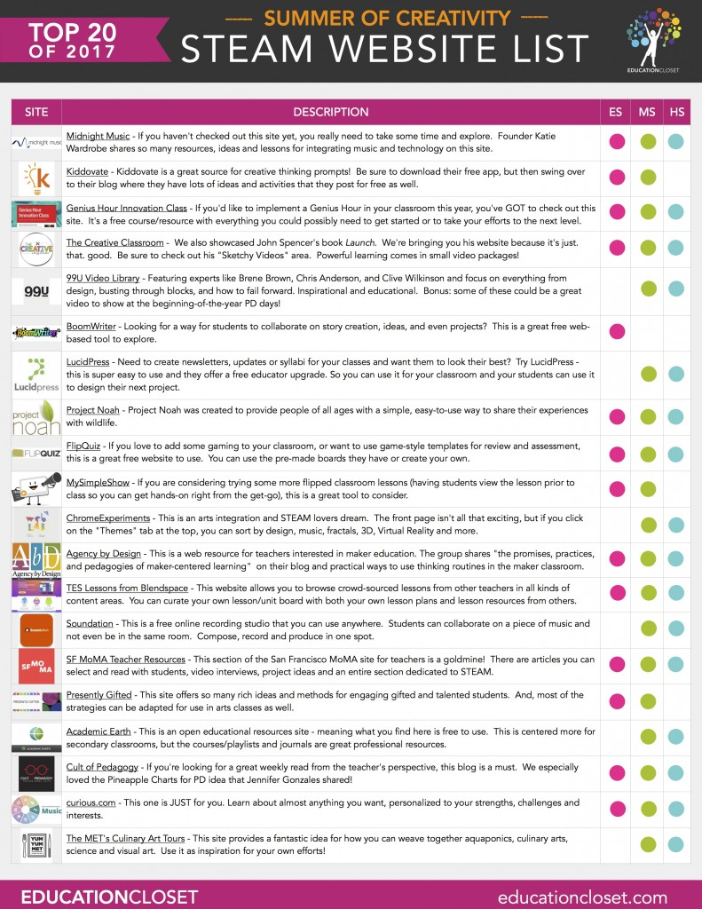



User
Maintenance
Portal
Data
Feedback
Classification
Save/Train
Load
Affordability
Architecture
Reputation
Health & Safety
Scraper
Websites

Slide 26
More
https://kckps.org/school-information/maps-elementary-boundaries/
https://data.kcmo.org/
http://datacatalogs.org/
https://www.activitytree.com/
https://www.activityhero.com/
https://www.education.com/
https://www.educationalnetworks.net/

Slide 27


